Slide 1


Imcgd214-Managing games production Imcgd111-Group project L4/5 GROUP 2
Jordan Marks
Alice Baker
Thomas Gibbs
Daniel Pokladek

Slide 2
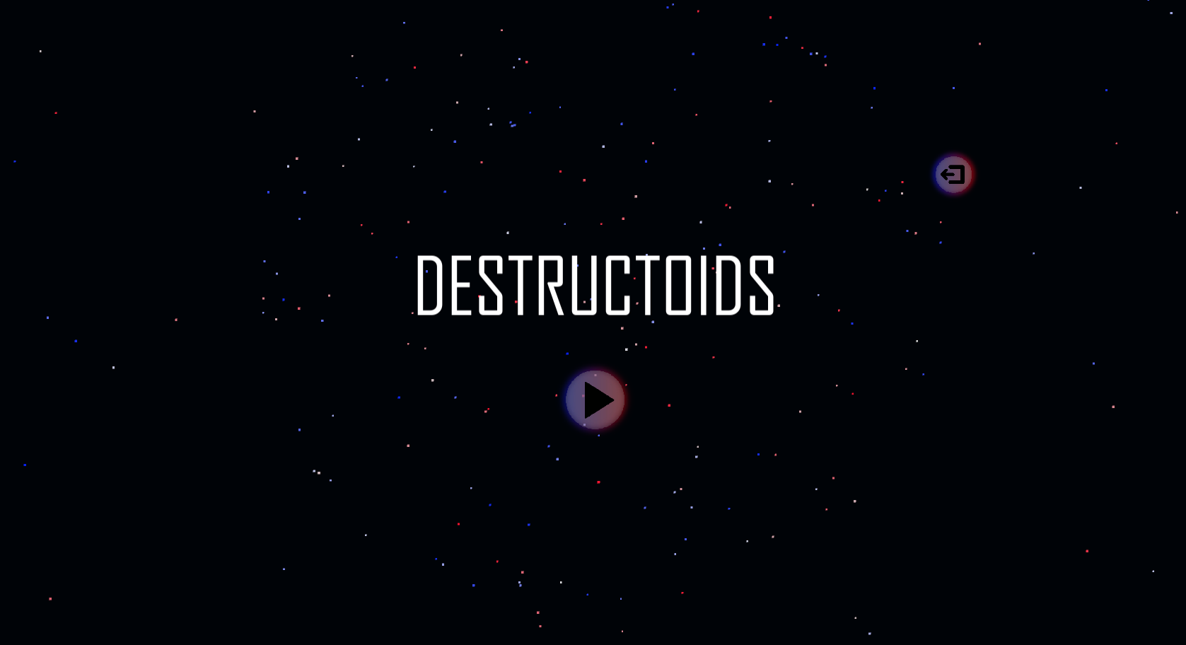
The brief
Physics based game
Easy to learn game yet hard to master
Adversarial Gameplay.
Symmetrical gameplay.
J

Slide 3
Logline and target audience
Logline – Beat your Foes in this gravity based planetary arena.
Target audience – 18-35 Male and Female
Platform – Mobile
J

Slide 4
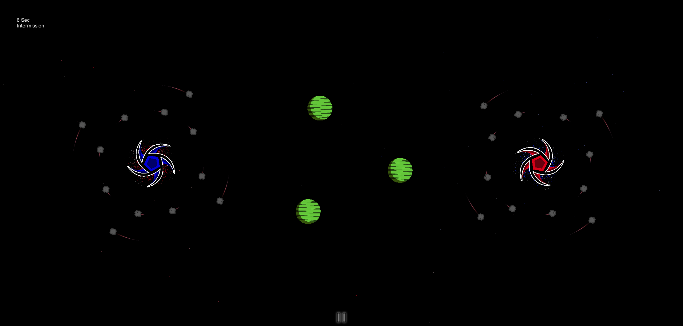
Game
What the player does
Physics in the game
Turn based game play
TD

Slide 5
Prototype
TD

Slide 6
how the game meets the brief
Two player –
Adversarial Gameplay.
Symmetrical gameplay.
Physics -
Gravity wells.
J

Slide 7
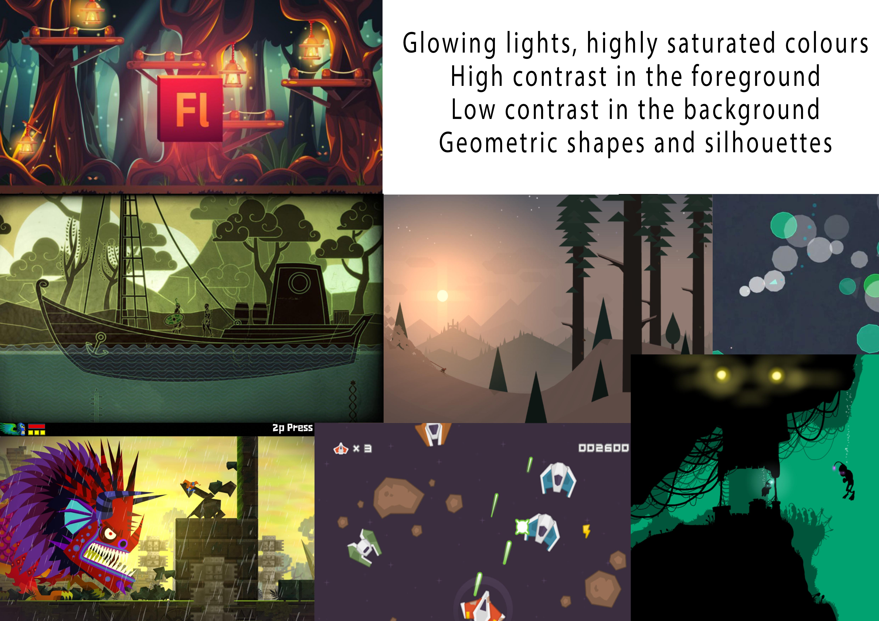
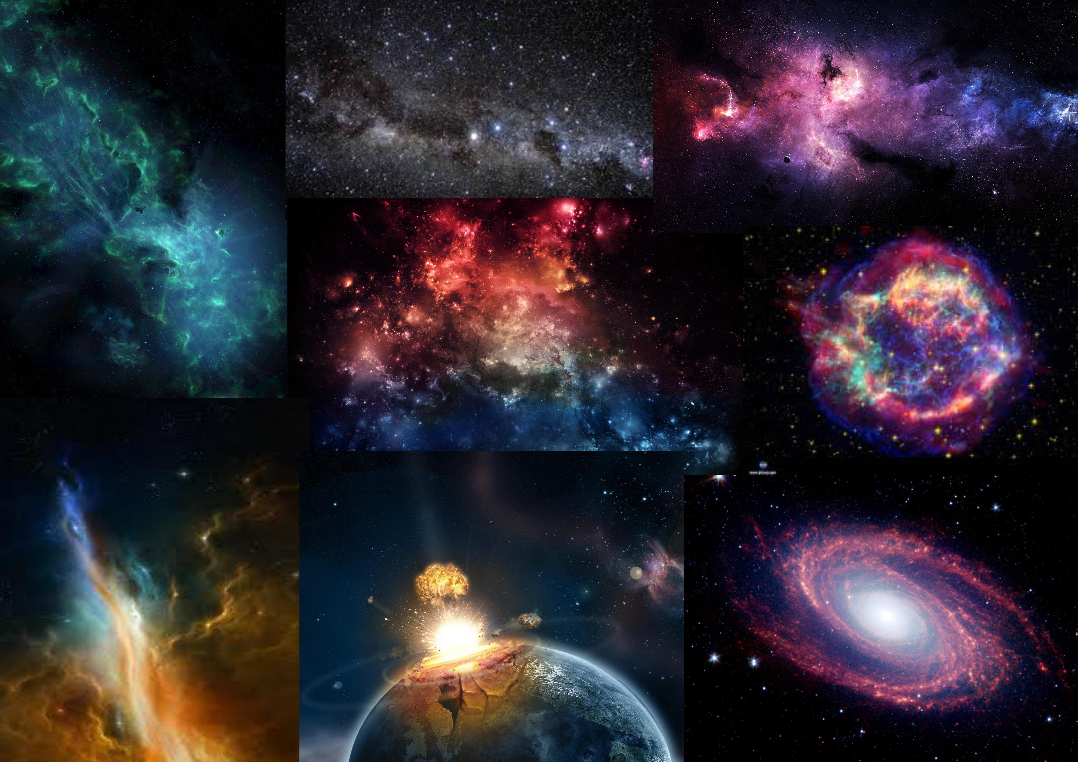
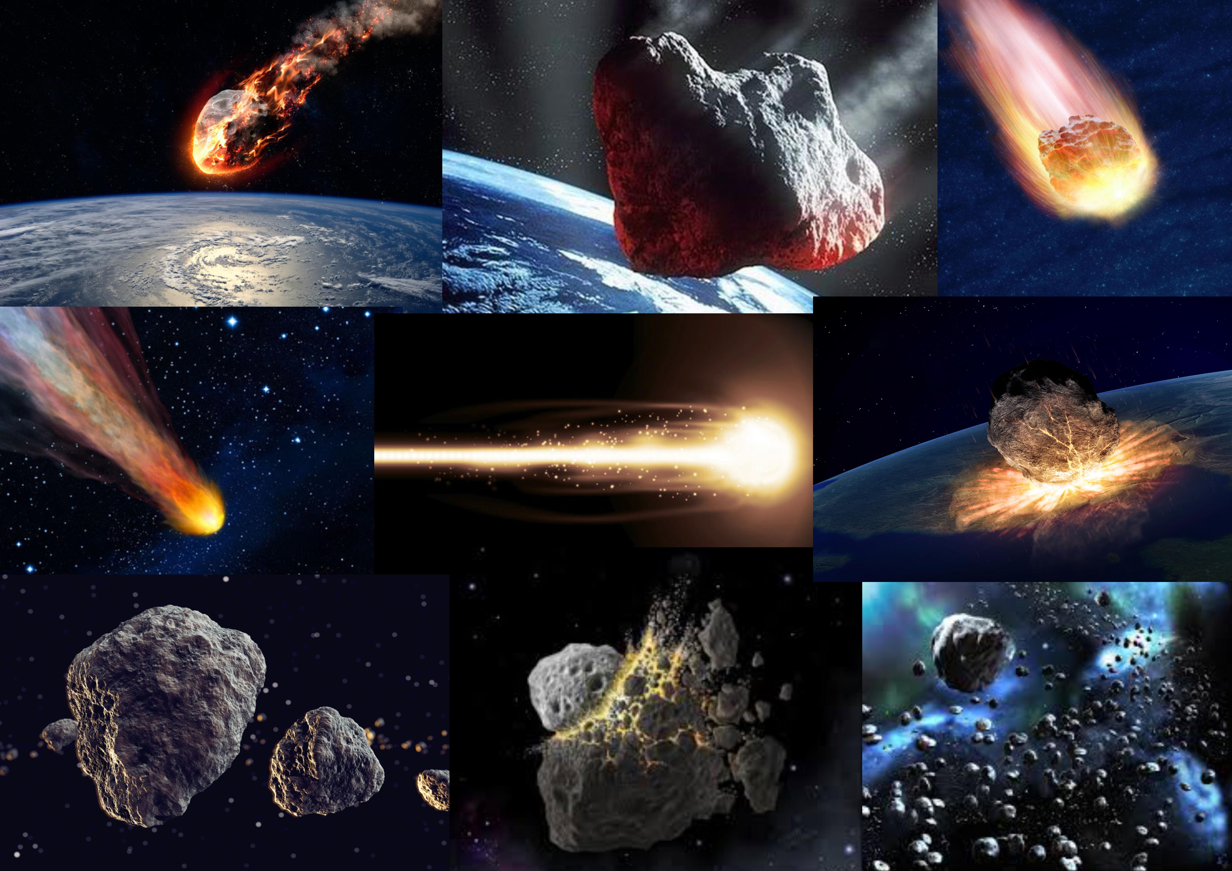

Art style and Moodboard
A

Slide 8




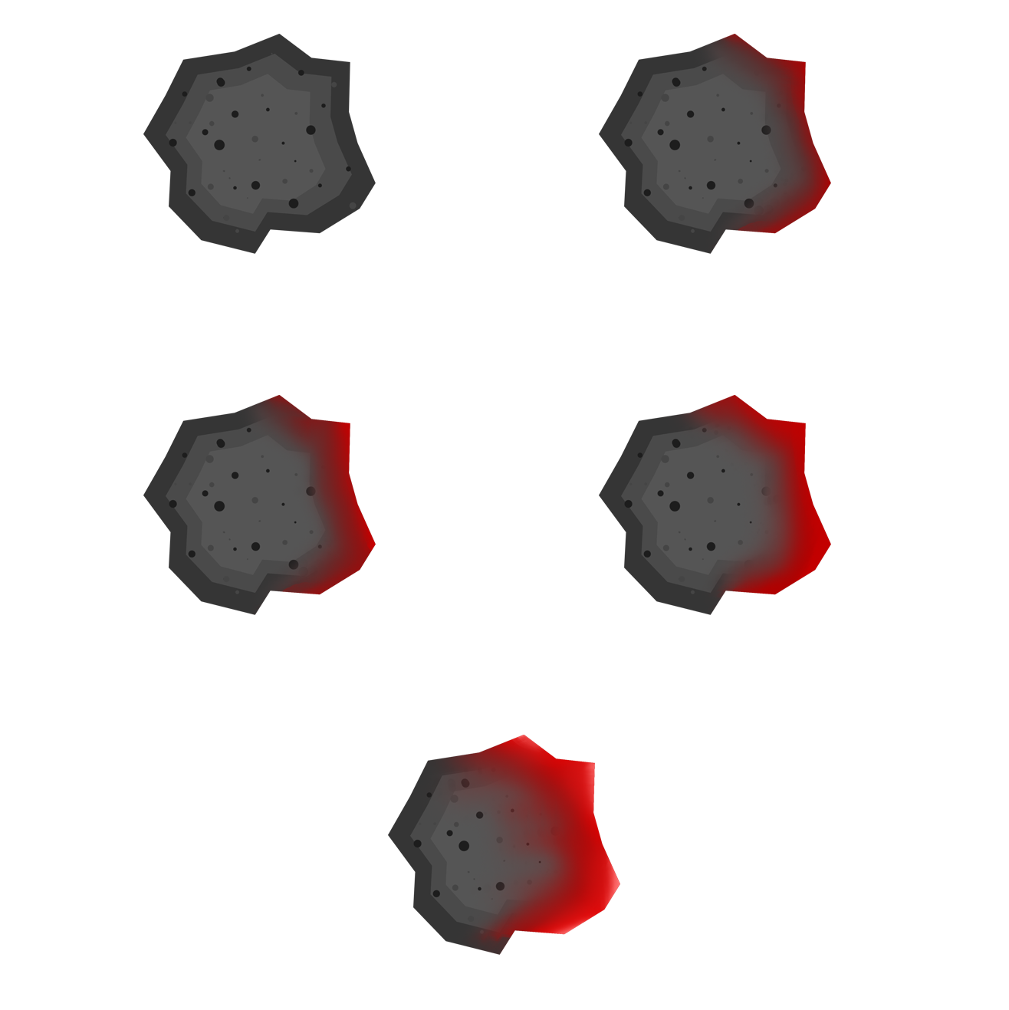









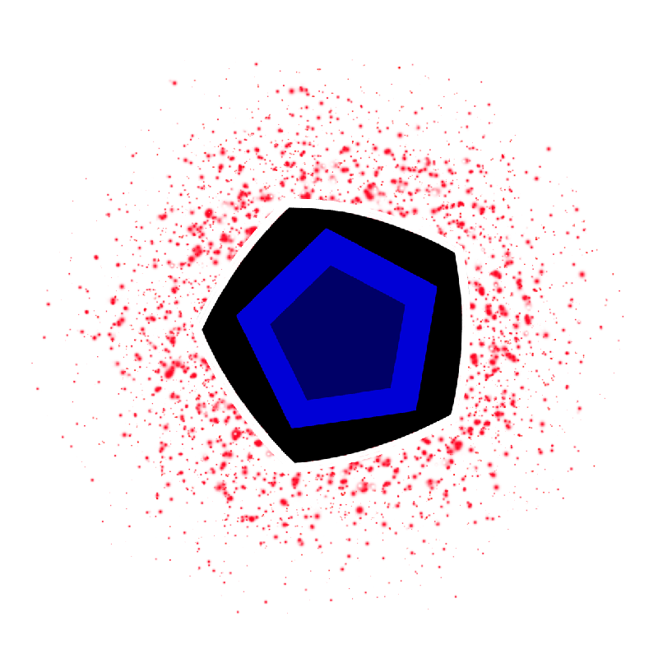
Game art
A

Slide 9
What we have delivered at the end of the project.
Fully playable Prototype of the game
Game have been Playtested by the most players we can.
J

Slide 10
management
Emails
Jordan - 45
Alice - 32
Dan - 16
Tom - 19
Hours (For the last for week)
Jordan - 48 Hours (6 Hours)
Alice - 50 Hours (6 Hours)
Dan - 49 Hours (6 Hours)
Tom - 49 Hours (6 Hours)
J

Slide 11
Questions?

